Slide 1
National Special Districts Association
Federal Update – June 2026
Eve O’Toole, Senior Managing Director
Mark Ritacco, Senior Advisor
Lisa Barkovic, Senior Advisor
Adrianna Williams, Policy Advisor

Slide 2
Agenda
01 | SDFAA of 2026 Updates
02 | NSDA Priority Issues: OMB Proposed Rule Update, Priority Reauthorizations, and 2026 Farm Bill
03 | Key Issues to Watch
04 | FY27 Appropriations + Grants Update

Slide 3
Special Districts Fairness and Accessibility Act (SDFAA) Update

Slide 4
Special District Fairness and Accessibility Act (H.R.2766/S.2014)
Status in Congress: The Special District Fairness and Accessibility Act currently has 24 bipartisan cosponsors (16 Democrats, 8 Republicans) in the House, and 4 bipartisan cosponsors (2 Democrats, 2 Republicans) in the Senate. The House bill is still pending a full floor vote.
  Rep. Burgess Owens (R-UT-4) co-sponsored on June 8th, 2026, following our conversations during our May fly-in.
Advocacy Activity Updates: Manatt has continued outreach to offices following the May fly-in to encourage co-sponsorship of the bill, such as Reps. Harriett Hageman (R-WY), Lisa McClain (House Republican Conference Chair / R-MI), and Sen. John Barrasso (R-WY).
Next Steps:
  Schedule follow-up meetings/outreach with targeted member offices prior to August recess.
  Schedule meetings with House Oversight Majority Committee staff, Senate Homeland Security and Governmental Affairs (HSGAC) committee staff, and additional congressional leadership (i.e. Majority Leader Scalise).

Slide 5
Special District Fairness and Accessibility Act (H.R.2766/S.2014) – Summary of Member Targets for Cosponsorship
Members from NSDA Fly-In Meetings Interested in Special Districts:
  Examples: Reps. Maxine Dexter (D-OR), James Clyburn (D-SC), Jeff Crank (R-CO)
Members from NSDA States Without Cosponsorship of SDFAA:
  House: Florida, South Carolina, Nevada, Arizona, Wyoming, North Dakota, Nebraska, Texas, Louisiana, Missouri, Tennessee, Maine
  Senate: Florida, South Carolina, Colorado, Nevada, Wyoming, North Dakota, Nebraska, Texas, Louisiana, Missouri, Tennessee, Maine
Members to Bolster Republican Cosponsorship:
  Examples: Reps. Ken Calvert (R-CA), Tom Barrett (R-MI)

Slide 6
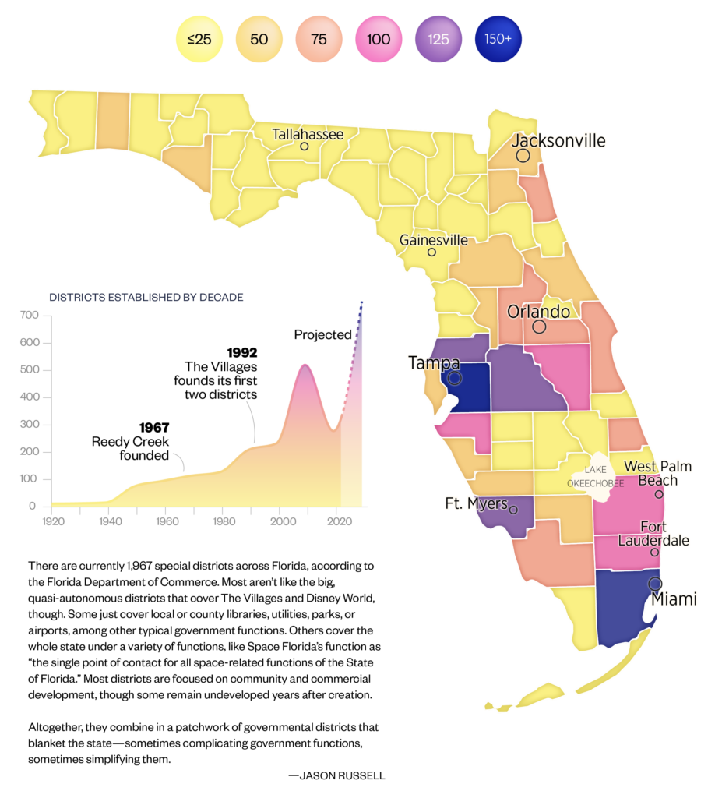
Special District Fairness and Accessibility Act (H.R.2766/S.2014) –Additional Targeting by Special District Density (FL Example)
Suggested Members to Target:
  Tampa: Reps. Kathy Castor (D-FL) Laurel Lee (R-FL)
  Miami: Reps. Frederica Wilson (D-FL), María Elvira Salazar (R-FL)
  Fort Meyers: Rep. Byron Donalds (R-FL)
  Orlando Metro: Rep. Maxwell Frost (D-FL), Mike Haridopolos (R-FL), and Darren Soto (D-FL)

Slide 7
NSDA Priority Issues: OMB Proposed Rule Update, Priority Reauthorizations, and 2026 Farm Bill

Slide 8
OMB Proposed Rule
The Office of Management and Budget (OMB) has proposed a wide-ranging rule aimed at reworking the federal funding award process for local governments, organizations, and institutions. The proposal would give agencies broad authority to halt awards if they determine a grant no longer serves program goals, agency priorities or the national interest.
The administration is providing a 45-day comment period that closes July 13 and is aiming to issue a final rule by October 1.
NACo, NLC, USCM, GFOA, ICMA, and IMLA sent a letter to OMB requesting an extended comment period, arguing that the 45-day comment period was not sufficient to analyze and respond to the proposal.

Slide 9
Priority Legislation / Reauthorizations
21st Century ROAD to Housing Act: The House and Senate passed an amended 21st Century ROAD to Housing Act in 358-32 and 85-5 votes, respectively. The legislation, which represents most of the significant housing packages Congress has considered in decades, is designed to address housing affordability by increasing housing supply, expanding homeownership opportunities, and reducing barriers to housing development.
  On June 24, President Trump abruptly canceled a bill signing for the package, saying he would not support the legislation until Congress passes the SAVE America Act, Republicans’ federal citizenship and voter ID bill.
2026 Farm Bill: The House passed its version of the farm bill (H.R.7567) on April 30, 2026, in a 224-200 vote. The Senate released its version of the legislation on June 23, 2026. The Senate bill is largely similar to the House package, as both bills expand resources for rural farmers, boost investment in federal farm loan programs, streamline conservation programs, and preserve crop insurance and the farm safety net.
  Both bills include a provision to extend Good Neighbor Authority to special districts.
Surface Transportation: The House T&I Committee advanced its BUILD America 250 Act on May 22, 2026, in a 62-2 vote. The legislation authorizes nearly $580 billion in total spending from FY 2027 – FY 2031. The House T&I; Science, Space & Technology; and E&C Committees have each advanced legislation within their respective jurisdictions, while the Ways and Means Committee has not released its portion of the bill addressing Highway Trust Fund revenues, user fees, and tax provisions. The Senate has yet to released draft bills and hold markups of its surface transportation reauthorization bill.
Water Infrastructure Reauthorization: Senate EPW and House T&I Committees aim to begin drafting in 2026. Both committees accepted priorities from Members and stakeholders in Q4 2025 / Q1 2026. Programs are set to expire on September 30, 2026.

Slide 10
Priority Legislation / Reauthorizations: 2026 Farm Bill Update
On June 23, 2026, the Senate Agriculture, Nutrition, and Forestry Committee released a discussion draft of their version of the 2026 Farm Bill, entitled the Agricultural Act of 2026.
  The House passed its version of the 2026 Farm Bill, the Farm, Food, and National Security Act of 2026 (H.R. 7567), on April 30, 2026, by a bipartisan vote of 224-200.
The bills both include provisions to extend Good Neighbor Authority to special districts. Both bills also modify federal food assistance programs for low-income households, expand producers’ access to credit, promote precision agriculture, improve risk management tools for specialty crop producers, lower energy costs, and enhance conservation programs for working lands.
Key differences in the Senate's bill:
  Reauthorizes and makes multiple changes to several U.S. Department of Agriculture (USDA) water infrastructure grant programs, as well as establishes new water infrastructure programs.
  Removes multiple provisions in House bill that address wildfire suppression, including: categorical exclusions for forest thinning, required USFS suppression of wildfires within 24 hours of detection, and the establishment of a new public-private wildfire technology deployment and testbed partnership program.
  Excludes a House provision that removes California’s Proposition 12 requirement that addresses living conditions for livestock in other states that are later sold to the state.

Slide 11
Key Issues to Watch

Slide 12
Safeguarding Charity Act (S.1428/H.R.2896)
Sen. James Lankford (R-OK) and Rep. Greg Steube (R-FL) reintroduced the Safeguarding Charity Act on April 10, 2025. The bill clarifies that an organization's tax-exempt status does not constitute federal financial assistance, meaning those organizations would not be subject to federal regulations/oversight tied specifically to receiving federal funding.
The legislation would be applicable to tax-exempt entities, including those with 501(c)(3) and 501(c)4 organizations. However, the bill is primarily intended to protect churches, religious schools, and charities from burdensome federal regulations.

Slide 13
Fire Apparatus Cost Issues
Multiple local governments are suing major fire apparatus manufacturers alleging an anticompetitive scheme—centered on industry consolidation, price-fixing, and supply restrictions—that has driven sharp cost increases and multi‑year delivery delays for essential firefighting equipment, straining municipal budgets and public safety planning.
  The Senate Homeland Security and Governmental Affairs Committee (HSGAC) held a hearing in 2025 to assess this ongoing fire apparatus crisis.
Recommended Advocacy: Ask Congress to increase funding for the AFG grants noting that with the large price increases, current funding available does not match market need.

Slide 14
FEMA Report Implementation
The Federal Emergency Management Agency (FEMA) Review Council released its final report in April 2026, outlining its recommendations to reform federal disaster response, recovery, and mitigation programs.
However, the House Homeland Security appropriations bill includes report language, stating that “recommendations stemming from the Final Report are merely proposals.” FEMA shall denote any instance in which the inclusion of such recommendations in the fiscal year 2028 budget submission impact a [program, project or activity (PPA)] funded in fiscal year 2027.”

Slide 15
FIRE SMART Act Update
On June 17, Senators Alex Padilla (D-CA) and John Curtis (R-UT) introduced the FIRE SMART Act, which amends EPA’s Drinking Water State Revolving Fund (DWSRF) program to expand eligibility for water infrastructure projects with both drinking water and wildfire suppression benefits, and are in communities at high risk for wildfires with fewer than 50,000 residents.
  Additional co-sponsors include Senators Tim Sheehy (R-MT), Mark Kelly (D-AZ), John Boozman (R-AR), Adam Schiff (D-CA), Mike Crapo (R-ID), and Jeff Merkley (D-OR).
This legislation is intended to ensure that rural SRF applicants – including special districts serving rural areas – can optimize water infrastructure to ensure that emergency responders can utilize it to quickly save lives and property during an active wildfire.
NSDA has officially endorsed the FIRE SMART Act and will continue to provide updates as the legislation advances.

Slide 16
FIRE SMART Act Update – NSDA Endorsement Quote
“The National Special Districts Association strongly supports the FIRE SMART Act to strengthen water infrastructure in communities at high risk of wildfire.
With more than 10,000 special districts nationwide providing fire protection and/or drinking water services, federal investments in water infrastructure—including projects that support fire suppression—are critical to ensuring community safety and resilience.
By providing targeted flexibility within the Drinking Water State Revolving Fund (DWSRF), this legislation will help local agencies, particularly in rural and high-risk areas, invest in projects that deliver both safe drinking water and reliable fire suppression capacity.
NSDA looks forward to working with Congress to advance this practical, locally driven approach to protecting lives, property, and essential water systems.”

Slide 17
Federal Appropriations + Grants Update

Slide 18
FY27 Appropriations Update
The House Appropriations Committee has advanced 11 of 12 FY27 appropriations bills, with the exception of the FY27 Defense bill. The House passed Agriculture and Military Construction-Veterans Affairs bills with a floor vote. Funding allocations under key House Appropriations bills include:
  Department of Transportation (DOT): $28.29 B (+$1.177 B above FY26 enacted levels)
  Department of Housing and Urban Development (HUD): $71.377 B (-$5.942 B below FY enacted levels)
  Department of Justice (DOJ): $38.612 B (+$1.563 B above FY26 enacted levels)
  Department of Homeland Security (DHS): $64.9 B (+$500 M above FY26 enacted levels)
  Federal Emergency Management Agency (FEMA): $34.067 B (+$2.039 B above FY26 enacted levels)
  U.S. Department of Agriculture (USDA): $22.5 B (-$675 M below FY26 enacted levels)
The Senate Appropriations Committee canceled mark-ups this past week due to disagreement between Senate Appropriations Committee Chair Susan Collins (R-ME) and Vice Chair Patty Murray (D-WA) over how to split discretionary funding between defense and non-defense priorities.
Ongoing Senate appropriations delays is raising the likelihood of a short-term continuing resolution (CR) in advance of the September 30, 2026 deadline. In addition, a shift in House control after the midterms could alter funding priorities and potentially change the contents of FY27 appropriations bills.

Slide 19
FY27 Appropriations Update
Program | FY26 Final | FY27 House | Difference
Assistance to Firefighters Grants | $342 M | $351 M | + $9M
SAFER Grants | $342 M | $351 M | + $9M
Institute of Museum and Library Services | $291.8 M | $291.8 M | No change
Clean Water State Revolving Fund (CWSRF) | $1.638 B | $1.192 B | - $446M
Drinking Water State Revolving Fund (DWSRF) | $1.126 B | $910.755 M | - $215M
FTA Buses and Bus Facilities | $490.358 M | $490.358 M | No change
Public Housing Fund – Capital Fund | $3.2 B | $2.286 B | - $914M
Public Housing Fund – Operating Fund | $5.024 B | $4.6 B | - $424M
Choice Neighborhoods Initiative | $25 M | $0 | - $25M

Slide 20
Federal Grants Outlook
Agency | Program | Description | Deadline
Department of Transportation (DOT) | INFRA Grants | Funds surface transportation infrastructure projects of national or regional signiﬁcance that improve the safety, efficiency, and reliability of the movement of people and goods in addition to expanding safe, accessible public parking for commercial motor vehicles. | 7/1/2026 + 7/15/2026
Department of Homeland Security (DHS) | Building Resilient Infrastructure and Communities (BRIC) | Funds hazard mitigation opportunities, prioritizing investment in infrastructure and construction projects that deliver immediate, measurable risk reduction to communities vulnerable to natural hazards. | 7/23/2026
DOJ - Community Oriented Policing Services (COPS) | COPS Hiring Program | Funds law enforcement agencies to hire and/or rehire additional career sworn law enforcement officers/deputies in an effort to increase their community policing capacity and crime prevention efforts. | 7/23/2026
Department of Housing and Urban Development (HUD) | PRO Housing | Rewards communities that have taken steps to remove regulatory barriers to building and preserving homes by providing funding to further expand affordable housing, particularly homeownership opportunities and housing located in Opportunity Zones and rural communities. | 8/3/2026
Department of Housing and Urban Development (HUD) | Continuum of Care | Promotes a community-wide commitment to ending homelessness by providing funding to rapidly rehouse individuals and families experiencing homelessness—including those ﬂeeing domestic violence—and to minimize trauma and dislocation. | 8/26/2026

Slide 21
Questions?

