Slide 1
NSDA Federal Advocacy Update – May 2026
Eve O’Toole, Senior Managing Director
Mark Ritacco, Senior Advisor
Lisa Barkovic, Senior Advisor
Adrianna Williams, Policy Advisor

Slide 2
Agenda
01 | Special Districts Fly-in Recap and Additional Cosponsors
02 | Surface Transportation Reauthorization Update
03 | FEMA Review Council Report Update
04 | Water Infrastructure Updates: PFAS Proposed Rule
05 | FY27 Appropriations Update
06 | Housing Update

Slide 3
Special Districts Fly-in Recap and Additional Cosponsors

Slide 4
Special District Days Fly-In Recap
NSDA members successfully held 27 meetings with congressional leadership/committees, the White House, and Members of Congress from seven states, including: FL, CA, SC, WY, TX, UT, and CO.
Key Takeaways / Questions:
  Successfully educated congressional staff about the importance of special districts and the need for bill to give special districts equal opportunities to access federal funding.
  Multiple staffers interested in engaging with appropriate congressional leadership / influential members to help convey urgency of bill (i.e. White House IGA, Speaker’s Office, Sen. Rick Scott, etc.)
  Multiple questions about stance of other local government advocacy organizations on bill.

Slide 5
Special District Days Fly-In: Next Steps
Follow-Up Meetings:
  House Majority Leader Steve Scalise (R-LA)
  House Oversight and Government Reform Committee (Majority)
Request Additional Members to Co-Sponsor Bill (i.e. WY, FL, SC, CO)
Sen. Rand Paul Follow-Up: Connect with additional Kentucky districts to raise awareness of bill / increase pressure on Sen. Paul for markup.
Share NSDA fact sheets with multiple offices in follow-up.

Slide 6
Surface Transportation Reauthorization Update

Slide 7
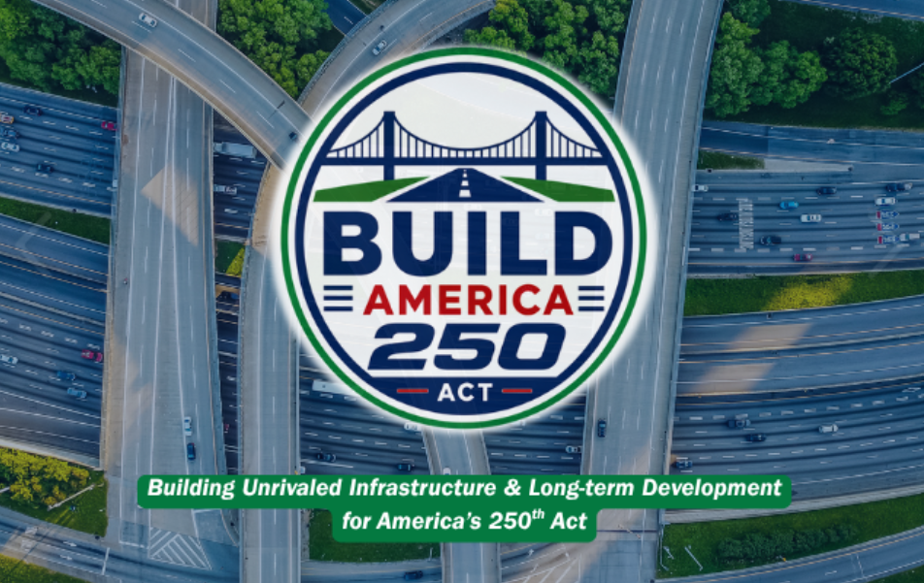
Surface Transportation Reauthorization Update
On Sunday, May 17, the House Transportation & Infrastructure (T&I) Committee introduced the bipartisan Building Unrivaled Infrastructure and Long-term Development (BUILD) for America’s 250th Act (BUILD America 250 Act), a legislative package to reauthorize and reform federal surface transportation programs and laws. The legislation authorizes nearly $580 billion in total spending from FY 2027 – FY 2031, including:
  $392.324 billion for the Federal-Aid Highways programs;
  $102.74 billion for Public Transportation;
  $64.656 billion for Railroads/Hazardous Materials programs;
  $17.75 billion for freight/multimodal transportation programs;
  $5.675 billion for highway traffic safety programs; and
  $5.04 billion for motor carrier safety programs.
Furthermore, local governments are estimated to have access to nearly 22 percent of funding included within the bill.

Slide 8
Surface Transportation Reauthorization Update
Key Programs Protected | Key Programs Repealed | New Programs
Consolidated Rail Infrastructure and Safety Improvements (CRISI) Program Railroad Crossing Safety Improvements and Elimination Program National Intercity Passenger Railroad Partnership Program Safe Streets and Roads for All Program Wildlife Crossings Pilot Program Bridge Investment Program Bus and Bus Facilities Program SMART Grant Program Mega Grant Program INFRA Grant Program | Healthy Streets Program PROTECT Formula Funding Charging and Fueling Infrastructure (CFI) Grant Program National Electric Vehicle Infrastructure (NEVI) Formula Program Carbon Reduction Program | Surface Transportation Accelerator Grant (STAG) Program Transportation assistance for international games program

Slide 9
Surface Transportation Reauthorization Update
New EV Fee: Requires states to impose an annual registration fee of $130 for electric vehicles (EVs) and $35 for covered plug-in hybrid vehicles to generate revenue for the Highway Trust Fund.
Build More Housing Near Transit Act Included: Allows for Capital Investment Grant (CIG) applicants to receive an additional point on their overall application score if said project also promotes housing development along the project route.
Bridge programs, 25% set-aside: The program also requires that states set-aside 25 percent of funds to run a competitive process to fund locally-owned bridge projects. (up from 15%).
New security / accessibility requirements for UZA formula funds: Amends Urbanized Area Formula grants to require recipients to allocate a minimum amount of funding to security and accessibility.
Fare Evasion Policy Enforcement: Allows DOT to withhold ten percent of urban area transit grant funds if said local jurisdiction does not have criminal or civil enforcement mechanisms to protect against fare evasion.
Buses and Bus Facilities Program: Consolidates the low-no emission bus and bus and bus facilities grant programs into one program. Modifies the bus and bus facilities competitive program and ensures that all vehicle propulsion types remain eligible.

Slide 10
FEMA Review Council Report Update

Slide 11
FEMA Review Council – Final Report Update
On May 7, the Federal Emergency Management Agency (FEMA) Review Council released its final report, outlining its recommendations to reform federal disaster response, recovery, and mitigation programs. The Council’s final report details 10 recommendations:
  Equip SLTT to lead disaster response with the federal government in a supporting role.
  Enhance critical federal programs & resources to support communities
  Realign the criteria for federal disaster assistance
  Replace the Hazard Mitigation Grant Program with a two-phase funding structure
  Streamline the Individual Assistance Program into a single direct payment program
  Reform the Public Assistance program to provide direct funding block grants
  Reform the National Flood insurance Program for financial stability and risk resilience
  Maximize every dollar spent by reducing administrative costs
  Revitalize a Unified National Network for Partnership
  A Transformed Agency

Slide 12
FEMA Review Council – Final Report Update
  Program Consolidation:
    Consolidate FEMA’s Individual Assistance program into a single direct payment (the FAIR program)
    Eliminate Hazard Mitigation Grant Program (HMGP) and replace with the two-phase Refined Risk Reduction (R3P) model.
    Public Assistance program’s seven-phase reimbursement process would be replaced by the RAPID direct funding block grant.
    FEMA would be a “payer of last resort," requiring other federal agencies to exhaust their own benefit programs before accessing FEMA funds.
  Emphasis on Federal-State-Local Partnerships:
    Establishes a formal governing board of federal, state, local, tribal, and territorial (FSLTT) stakeholders to codify national minimum standards for incident response and recovery capabilities.
    Gives States authority to handle environmental reviews locally within the R3P program.
    Expedites funding for states and territories with approved hazard mitigation plans and a history of successful Hazard Mitigation Grant Program (HMGP) performance within the new R3P program.
  Urban Search and Rescue:
    Enhances funding and expands capabilities for the National Urban Search and Rescue Program’s network of 28 task forces.
    Recommends leveraging the National Urban Search and Rescue Program as a model to expand the State Urban Search and Rescue programs.

Slide 13
Water Infrastructure Updates: PFAS Proposed Rules Update

Slide 14
EPA PFAS Proposed Rules Update
On May 18, EPA proposed a partial rollback of the Biden-era PFAS drinking water rule, including eliminating limits for four chemicals and allowing utilities to request a two-year extension for compliance on two others.
EPA proposed this partial rollback through two proposed rules:
  SDWA Compliance Extensions: The first proposed rule would maintain national standards for PFOA and PFOS while allowing eligible water systems to seek up to a two-year compliance extension to address implementation challenges.
  Rescission of PFAS Limits: The second proposed rule would rescind and reconsider limits for four additional PFAS chemicals, citing concerns that the prior rulemaking did not fully comply with Safe Drinking Water Act requirements.
Once published in the Federal Register, EPA will accept public comments on both proposed rules for 60 days. EPA will also hold a virtual public hearing on both proposed rules on July 7, 2026.

Slide 15
FY27 Appropriations Update

Slide 16
FY27 Appropriations Update
The House Appropriations Committee has advanced 7 of 12 appropriations bills for floor consideration, including: Agriculture-FDA, Commerce-Justice-Science, Energy-Water, Financial Services-General Government, Legislative Branch, and State-Foreign Operations.
  The House also voted in favor of the Military Construction-VA bill earlier this month.
The House Appropriations Committee has also held subcommittee markups for the FY27 Transportation-HUD and Interior-Environment appropriations bills, and will begin holding subcommittee and full committee markups for the Homeland Security and Labor-HHS-Education bills the weeks of June 5th and June 9th, respectively.
The Senate Appropriations Committee is expected to begin holding markups in the first week of June.

Slide 17
FY27 Appropriations Update: THUD, Interior-Environment, and Energy-Water
Transportation-HUD Bill:
  Department of Transportation (DOT): $28.3 billion in discretionary funding (approximately $1.177 billion above the FY26 enacted level).
  Department of Housing and Urban Development (HUD): $71.38 billion in discretionary funding (nearly $6 billion below the FY26 enacted level).
Interior-Environment:
  Environmental Protection Agency (EPA): $7.04 billion for the Environmental Protection Agency ($1.8 billion (20%) below the Fiscal Year 2026 enacted level.
Energy-Water:
  Army Corps of Engineers: $9.775 billion for the Army Corps of Engineers (Corps) ($700 million decrease compared to FY26 levels).
  Bureau of Reclamation: $1.84 billion for the Bureau of Reclamation’s Water and Water-Related Resources account

Slide 18
FY27 Appropriations Update: Department of Transportation
DOT Program | FY26 Enacted | FY27 PBUD | FY27 House
BUILD (previously known as RAISE) | $145 million | $0 | $550 million
Federal Aviation Administration (FAA) | $22.2 billion | $22.356 billion | $22.665 billion
FAA Contract Tower Program | $279.2 million | $279 million | $303 million
Federal Highway Administration (FHWA) | $64.3 billion | $66.153 billion | $64.531 billion
FHWA Highway Formula Funding | $62.657 billion | $63.973 billion | $62.657 billion
FHWA Highway Infrastructure Grants | $2.395 million | $1.483 billion | $1.135 billion
Federal Transit Administration (FTA) | $16.5 billion | $16.314 billion | $16.509 billion
FTA Transit Infrastructure Grants | $211.4 million | $0 | $973.177 million
FTA Capital Investment Grants Program | $1.7 billion | $1.214 billion | $737.193 million
FTA Transit Infrastructure Formula Funding | $14.642 billion | $14.95 billion | $14.642 billion
FTA Passenger Ferry Program | $25 million | $0 | $0
Federal Railroad Administration (FRA) | $2.934 billion | $2.797 billion | $3.02 billion
Fed-State Partnership for Intercity Passenger Rail | $65 million | $0 | $0
Consolidated Rail Infrastructure and Safety Improvements (CRISI) | $137.42 million | $300 million | $522.775 million
Railroad Crossing Elimination (RCE) Program | $0 | $100 million | $100 million
Maritime Administration (MARAD) | $1.044 billion | $2.566 billion | $1.483 billion
Port Infrastructure Development Program (PIDP) | $103.3 million | $50 million | $0

Slide 19
FY27 Appropriations Update: Department of Housing and Urban Development
HUD Program | FY26 Enacted | FY27 PBUD | FY27 House
Tenant-Based Rental Assistance | $38.439 billion | $38.846 billion | $38.083 billion
Project-Based Rental Assistance | $18.543 billion | $17.64 billion | $18.975 billion
Public Housing – Capital Fund | $3.2 billion | $3.2 billion | $2.286 billion
Public Housing – Operating Fund | $5.024 billion | $5.377 billion | $4.737 billion
Choice Neighborhoods Initiative | $25 million | $0 | $0
Homelessness Assistance Grants | $4.417 billion | $4.024 billion | $4.16 billion
Housing Opportunities for Persons with AIDS (HOPWA) | $529 million | $0 | $529 million
Community Development Block Grant (CDBG) | $3.3 billion | $0 | $3.3 billion
Community Development Fund – EDI Earmarks | $3.615 billion | $0 | $2.522 billion
PRO Housing Program | $50 million | $0 | $0
HOME Investment Partnerships | $1.25 billion | $0 | $500 million

Slide 20
FY27 Appropriations Update: Environmental Protection Agency (EPA)
EPA Program | FY26 Final | FY27 PBUD | FY27 House
Clean Water State Revolving Fund (CWSRF) | $1.638 billion | $155 million | $1.192 billion
CWSRF Earmarks | $892.76 million | $0 | $525.48 million
Drinking Water State Revolving Fund (DWSRF) | $1.126 billion | $150 million | $910.755 million
DWSRF Earmarks | $715.364 million | $0 | $506.395 million
Midsize and Large Drinking Water System Infrastructure Resilience and Sustainability Program | $2.25 million | $2.25 million | $2.25 million
Water Infrastructure Finance and Innovation Act (WIFIA) Program | $64.634 million | $7.839 million | $64.634 million

Slide 21
Housing Update

Slide 22
21st Century ROAD to Housing Act Update
On May 20, by a vote of 396-13, the House adopted a revised version of the 21st Century ROAD to Housing Act and sent the legislation back to the Senate.
House Financial Services Chair French Hill (R-AR) and Ranking Member Maxine Waters (D-CA) released legislative text quickly after President Trump endorsed the Senate version of the housing legislation, which includes stronger language cracking down on institutional investors in the housing market.
Despite the House passing an amended version of the bill, though, Senators are likely to make further changes to the legislation.

Slide 23
21st Century ROAD to Housing Act Update
The amended 21st Century ROAD to Housing Act includes multiple provisions impacting local governments and public housing authorities, including but not limited to:
  HUD pilot program for public housing agencies and owners of federally assisted rental housing to install temperature sensors in dwelling (Section 105).
  Additional weight for grant applications with projects in designated Opportunity Zones to support housing preservation and construction (Section 201).
  Use of CDBG funds for affordable housing construction, enabling communities to direct up to 20% of their CDBG resources toward increasing their local housing supply (Section 204).
  Establishes a HUD pilot program to issue competitive grants to assist state, local, and tribal governments with implementing regional housing planning and community development activities, which sunsets in seven years (Section 207).
  Direct HUD to conduct a study on the implementation of work requirements by public housing agencies (Section 803).

Slide 24
Questions?

